Slide 1
Tribal Question and Answer Session
March 12, 2014

Slide 2
Agenda
Any AQS questions?
Data Certification is coming up, lets review the process.
New ‘How To’ Series:
How to create a site
Notes:
Here is our agenda. AQS Team is working on our privileges to the test database, they were lost with the last AQS QA database refresh. Therefore the demo is restricted to what I can do in the production database. In production we only have Read access.

Slide 3
Data Certification
Submit materials to your RO by May 1, 2014
Review Certification Webinar from April 2013
http://www.epa.gov/ttn/airs/airsaqs/training
Most of the Information for this presentation is from the AQS Certification Webinar held in April of 2013
Notes:
Just as an FYI….You should receive certification materials in March 2014 from EPA OAQPS.
You must submit your certification materials by May 1st.

Slide 4
What is Data Certification?
• Formal statement attesting to ambient data completeness and accuracy
• Submitted by monitoring agencies to EPA on annual basis
• Process that combines a required action followed by a discretionary EPA review
Notes:
So what is AQS Data Certification?

Slide 5
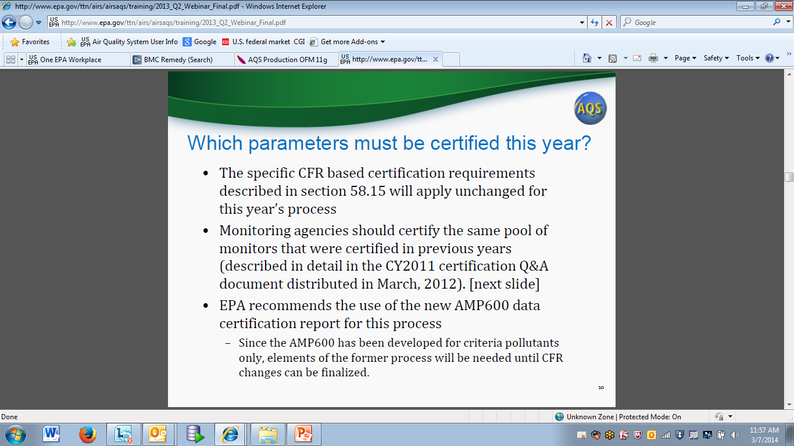
Notes:
From 2013 Webinar. Verified with the AQS Team if there was anything different for the certification process this year. Per AQS Team, the process is the same as last year. Here is information regarding certification requirements, the monitors which must be certified and information regarding the certification process (a new process implemented last year).

Slide 6
Which parameters must be certified?
All data from SLAMS* monitoring stations must be certified including criteria pollutant and other pollutants from the following monitors (* and SPM’s using FRM or FEM methods)
•Federal reference method (FRM) or Federal equivalent method (FEM) monitors for CO, NO2, SO2 (hourly and 5-minute average data), ozone, Pb-TSP, Pb-PM10, PM10, PM10-2.5, and PM2.5
•Continuous PM2.5 monitors
•Filter-based PM2.5 speciation monitors - (total mass and speciated components)
•NCore station precursor gas monitors for CO, SO2, and NO/NOx/NOy
•PAMS data (ozone, NO/NOx/NO2, VOC, carbonyl, NH3, and HNO3 if collected)
Which parameters must be certified this year
Notes:
Here are the specific pollutants which must be certified. This is from the 2013 Certification webinar.

Slide 7
Overview: A New Certification Process began last year
State Letter from Senior Official is submitted
AMP 600 + AMP 450NC Due: May 1 of each year
Following is the Regional Administrator Review and Concurrence:
Check AMP600 and concur with recommended/submitted certification flags
Check AMP450NC for correct monitor selections
Set Flags in AQS by monitor
Notes:
Here is an overview of the certification process which was implemented last year.

Slide 8
Which items must be submitted to the RO by May 1, 2013?
•Signed letter from senior air pollution control officer referencing monitors being certified (same as last year)
–Required Language for the Certification Statement - The certification statement from the responsible State or local official must indicate that (1) the ambient concentration data and the quality assurance data are completely submitted to AQS, and (2) the ambient data are accurate to the best of his or her knowledge taking into consideration the quality assurance findings.
•AMP600 for criteria pollutants
–Don’t need the Quick Look (AMP450) or AMP255 QA report any more
•AMP450NC for non-criteria pollutants (same as last year)
Notes:
As noted in the previous slide, these are the items which must be submitted by you to the RO by May 1st. This is the CFR requirement . Once you send this information you have met the CFR requirement and you are done.

Slide 9
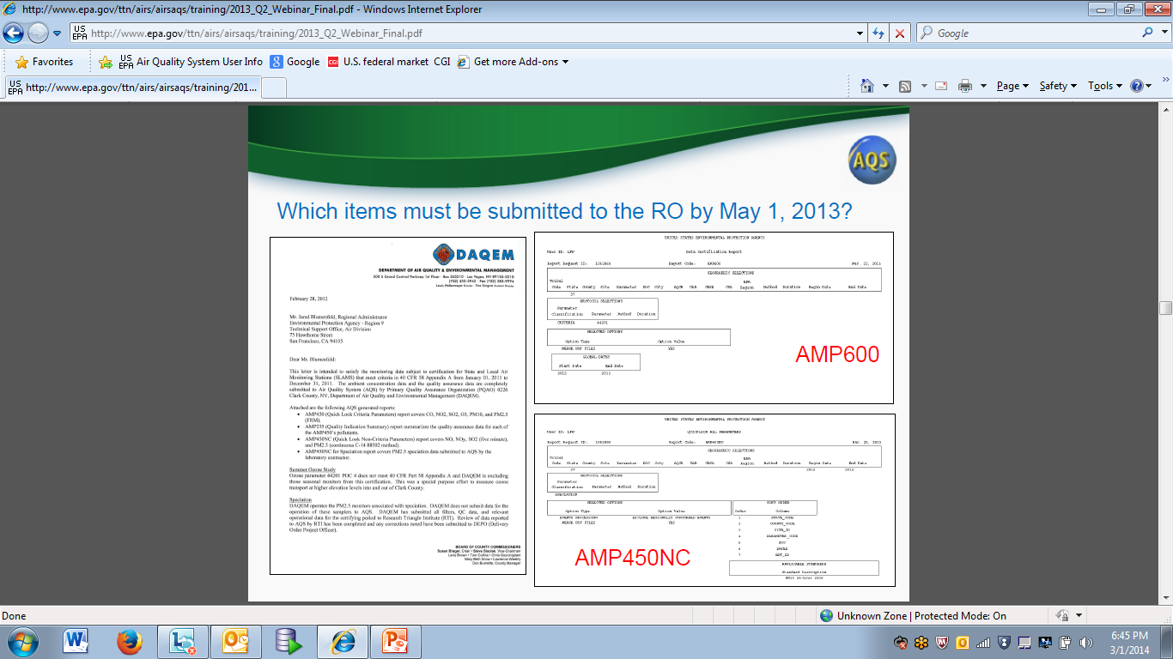
Notes:
Here is an example of the forms noted on the prior slides which must be submitted to the RO by May 1st. This is Clark County’s letter.
Webinar: http://www.epa.gov/ttn/airs/airsaqs/training/2013_Q2_Webinar_Final.pdf
Note in the letter you reference the monitors or specify the pool of monitors you are certifying and reference reports which have the monitors you are certifying. Letter addressed to Regional Administrator and signed by the Senior Official.

Slide 10
What happens after you submit the forms on May 1st?
•EPA Regional Office staff will begin reviewing certification packages following submittal and adding concurrence flags in AQS for criteria pollutants
–Follow-up conversations for incomplete submittals or questions regarding AMP600 recommended versus requested flags
Notes:
After you submit the forms…

Slide 11
Remember, last Year OAQPS did the following
1. Created two new AQS components:
a)New Data Certification Report – AMP600
b)New Certification form for recording state/local/tribal certification requests
2. Created a new monitor agency role, “Certifying Agency”, and assigned it to every active criteria pollutant monitor based on prior certification letter submissions to EPA regional offices.
Notes:
This was the certifying role for criteria pollutants. This was added to all monitors last year. Last year the AQS team asked all agencies to review this role in AQS and verify it is correct.

Slide 12
What does an agency do?
1. Conduct and complete ambient air quality monitoring and QA as per 40 CFR Part 58 and submit all relevant data to AQS.
2. For Criteria pollutants, run the Data Certification Report (AMP600) for your Certifying Agency.
a)This will calculate a recommended certification flag for each monitor-year based on Part 58 criteria and display the results for all monitors and PQAOs associated with the Certifying Agency.
3. Review the certification report. For ‘N’ recommendations (for example):
a)Has any ambient monitoring data not yet been submitted?
b)Has any QA/QC data (e.g. Precision and Accuracy transactions) not been submitted?
c)Should any ambient monitoring data be invalidated and removed from AQS based on QA/QC results?
4. Make corrections to AQS data as needed tor resolve an ‘N’ flags.
Notes:
Air monitoring and QA as stated by the CFR
Run AMP600 which gives you the results of evaluation criteria that are part of the standard process.
Continued on next slide

Slide 13
What does an agency do?
5. Re-run AMP600 Certification report and verify results
6. Repeat steps 4 and 5 until you are happy with the results of the report.
7. When happy with results, include this report in package to send to RO
OR - If you are still unhappy with your results and want to indicate a request for changes to your RO and include comments as to why you are recommending a change, then access the AQS Certification Form (click on Certification from the AQS menu bar). Make any requested changes on the Certification form. Save. Then rerun the AMP600 standard report one last time to include with your materials to the RO. The report will now show both AQS recommended value and Certifying Agency requested value, and Certifying Agency comments when different.
8. For non-criteria pollutants, run the AMP450NC report as in past years.
9. Prepare Certification Letter
10. Send AMP600, AMP45NC and Certification letter to your RO

Slide 14
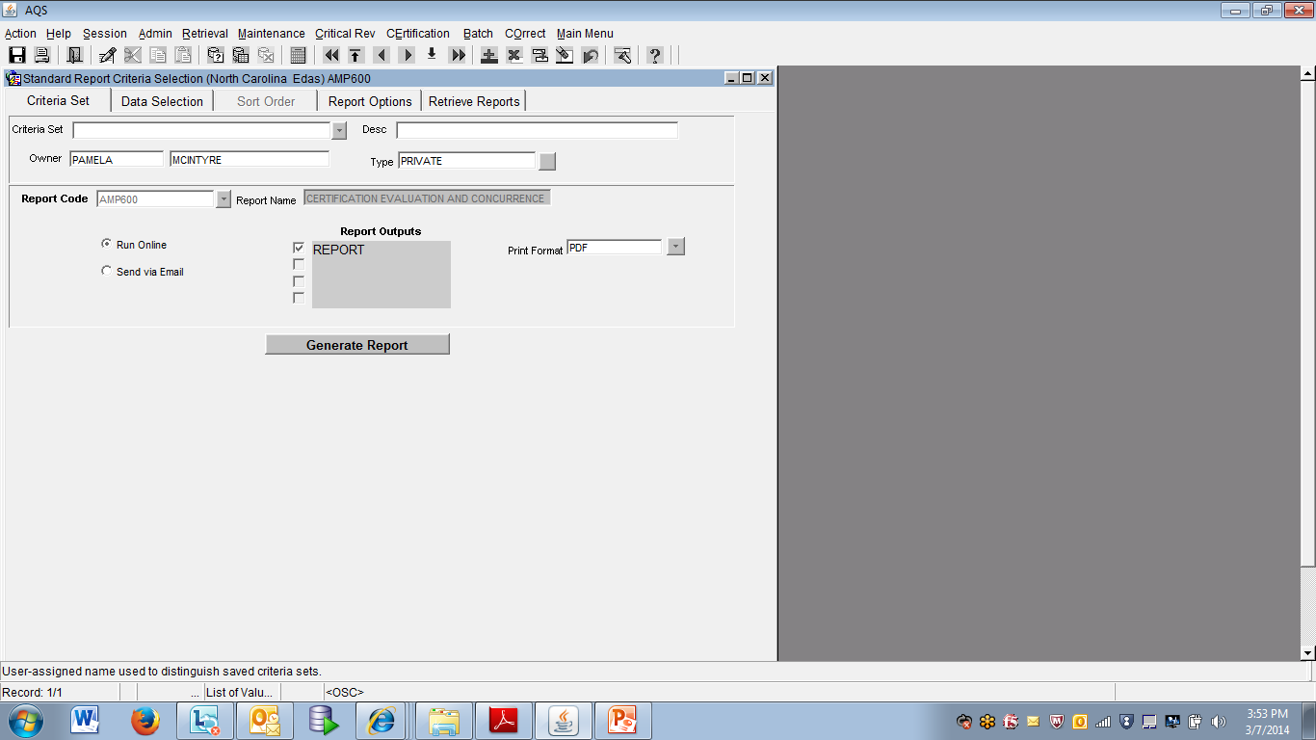
Notes:
Here is an example of how to access the AMP600 – Certification and Evaluation Concurrence Report. Choose report code AMP600 and send via Email

Slide 15
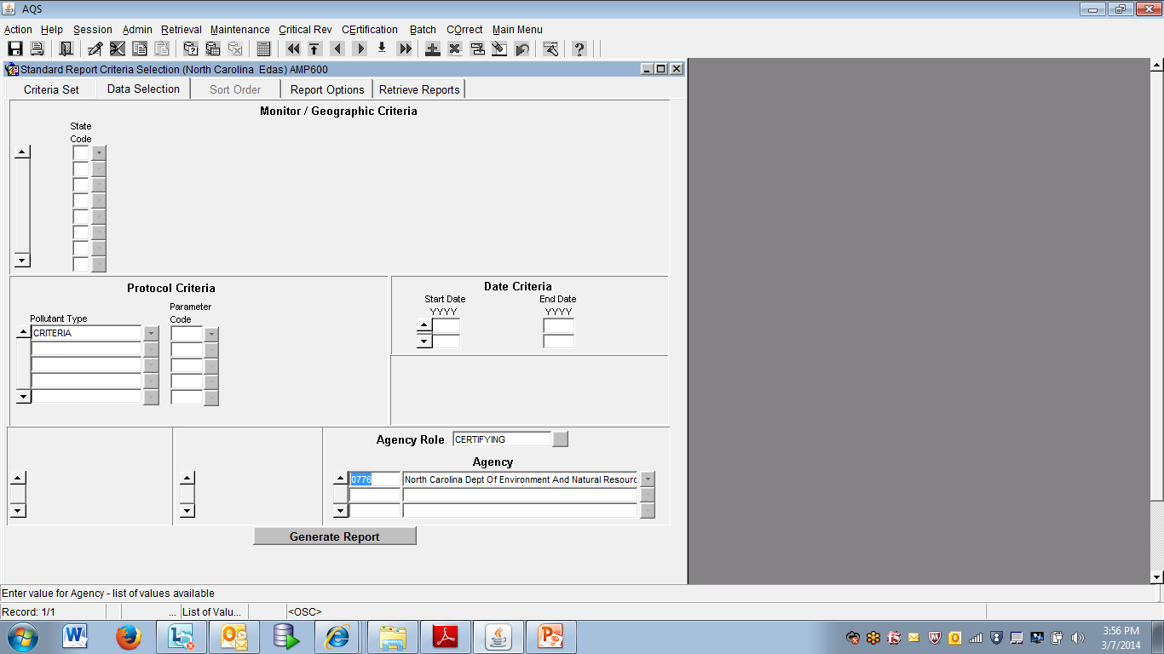
Notes:
This is how you fill out the criteria selections
Choose your Certifying Agency from the Agency drop-down.
Specify the year for the data – can only run one year at a time, not multiple years
For the other fields you can enter multiple lines of data
Can monitor report progress on the ‘Retrieve Reports’ tab
Will get email when the report is done

Slide 16
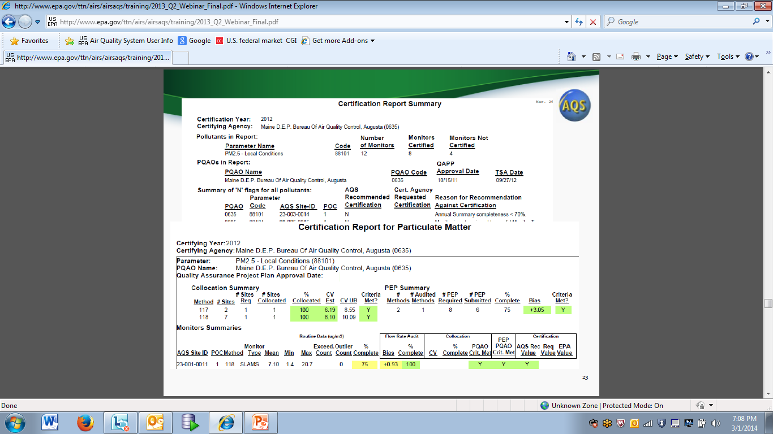
Notes:
Here is a what the AMP600 Report looks like
Contents of report:
Summary Section
Detail Section – type of pollutants broken down
Shows PQAO which have monitors within your certifying agency
Look at the monitors failing the certification
Some of the information is the same as what is on the quick-look report and some of information is similar what is on the AMP255
Review any monitors with the ‘N’ flag that AQS recommends against certification. Make any corrections and then rerun the report until you are happy with the results. Include report with materials to send to RO.
However, if you are still unhappy with the results displaying on the report and want to request a change to the RO then access the AMP600 Form (next slide)
If meeting the CFR it will be ‘green’, close to meeting the CFR is ‘yellow’ and significantly below data quality objectives is ‘red’
In the 2013 Webinar, Robert Coats provides a detailed look at the summary and detail sections of the AMP600 report. For more information regarding these sections, please review this webinar.

Slide 17
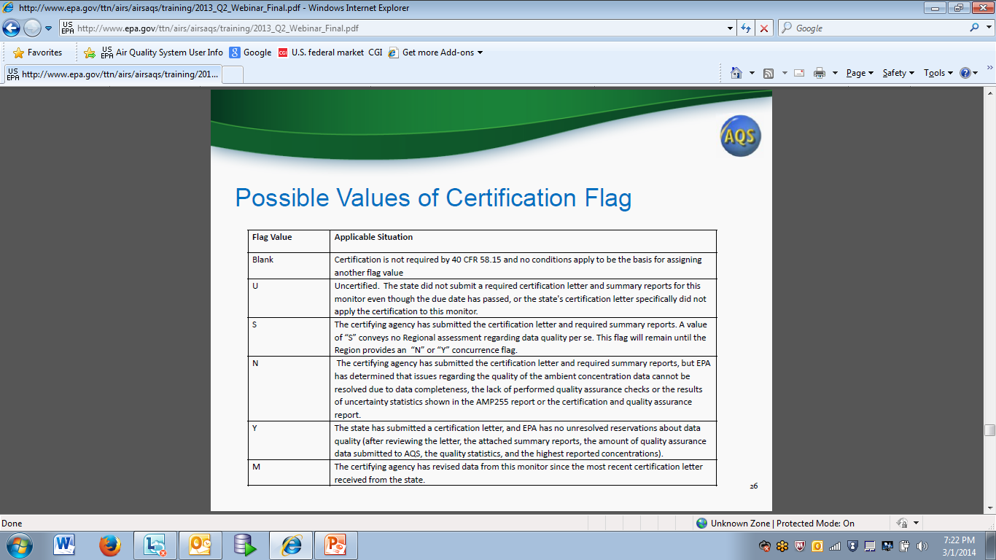
Notes:
Here are some possible certification flags which you may see on the AMP600 Certification Report. Lets review them.

Slide 18
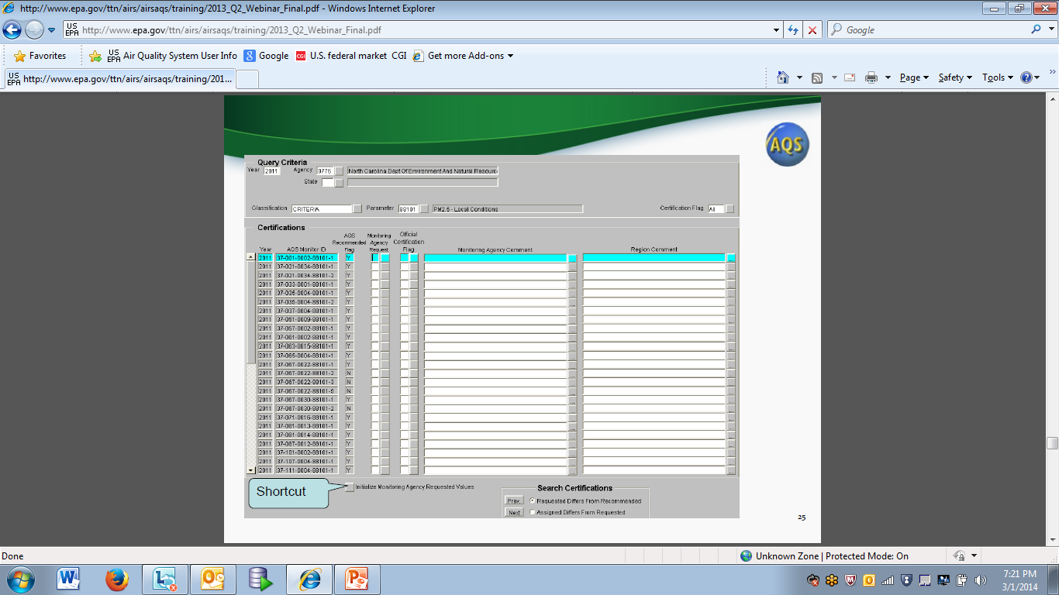
Notes:
If you want to indicate a change request for a certification ‘N’ value, access the AMP600 form by clicking on ‘Certification’ from the AQS menu bar.
Here is the Data Certification form which you can access from AQS Online Maintenance. (Because I do not belong to any certifying agency, I can not generate the form)
- The form defaults to the previous calendar year.
- Query your data by the Certifying Agency Code
- The form defaults to Criteria Pollutants
- You can also query for a specific pollutant
- Click on execute query button after enter query specifications
- Your query should retrieve all monitors associated with the certifying agency code
- You will see all recommended flags, there are three types of flags: AQS Recommended Flag, Monitoring Agency Request, Official Certification Flag
- You can initialize the monitoring agency requested values by clicking on the shortcut ‘ Initialize Monitoring Agency Requested Values’. This will set the Monitor Agency Request values to the same as the AQS Recommended Flag. If you AQS requested value is not what you want you can, you can specify a change to it by changing your ‘monitor agency requested value’ to what you want. You must also enter a comment afterwards. For the Comment if you click on the box to the right of the field you can type in more information…up to 2048 characters. When you are done ‘Save’.
After you have enter entered all your comments and changes with requested values on the Certification form, rerun the AMP600 and you will see your changes on the report as well. Sent this final copy of the AMP600 report along with your other materials to the RO for certification.
Regional office will set flag to concur or not concur – can see these flags on any report in AQS which has them such as the Quick Look or Design Value Reports
In the 2013 Certification Webinar, Robert Coats discusses outlier counts – statistical evaluation and critical anomalies.

Slide 19
Steps to Generate the Certification (AMP600) Form
1. Access Maintenance>Certification from menu bar in AQS
2. When the form comes up, query the data for your certifying agency / year.
a)Can subset data by pollutant
3. Use the “shortcut” button at the bottom of the form, “Initialize monitoring agency requested values”
4. If you want to request a change to the recommended value:
a)Scroll to the line to be changed
b)Change the “Monitoring Agency Request” column value
c)Enter the justification in the Monitoring Agency Comment
5. When you are done, click save.
Notes:
Here is how you generate the AMP600 report.

Slide 20
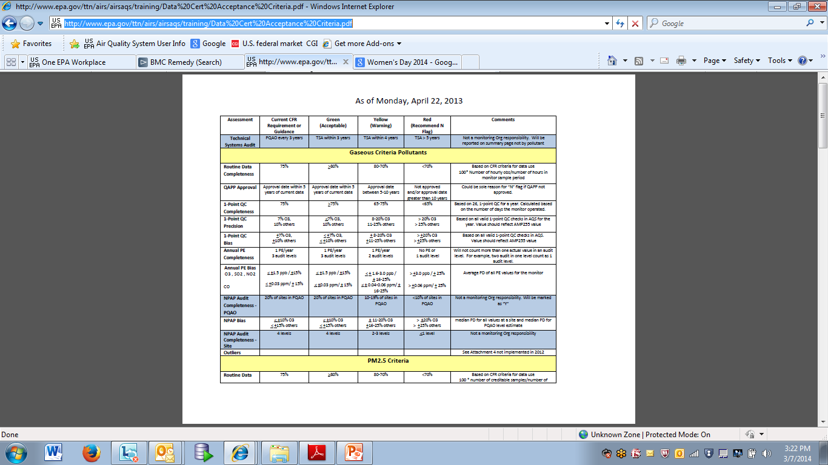
AQS Certification Criteria
http://www.epa.gov/ttn/airs/airsaqs/training/Data%20Cert%20Acceptance%20Criteria.pdf
Notes:
For information regarding the AQS Certification Criteria, please go to the following link. This was used last year. The AQS Team may provide enhancements to this criteria this year if needed.

Slide 21
FYI: Generating AMP450NC
Access Retrieval>Standard Reports
From the Report Code drop-down choose the AMP450NC report
Click on Data Selection to specify Criteria
Under ‘Pollutant Type’ change Criteria to ‘All Pollutants’ or specify the pollutants you want to certify

Slide 22
‘How to’ Series
How to create a Site

Slide 23
How to Create a Site
Create Site via.…
Online Maintenance
Maintenance>Site
Batch
Delimited text file (can use the AMP500 report to duplicate an existing site)
XML file
Notes:
You can create site online or in Batch. For Batch you can use a delimited or XML file.

Slide 24
Some things you may need….
Print AQS Site form and fill out beforehand
Your Tribal Code as designated by the AQS Team
Your chosen site id – see site info slide
AQS Data Coding Manual for reference
Contact information of person who set up site
Contact information for your AQS Regional Representative
http://www.epa.gov/ttn/airs/airsaqs/AQSROContacts.pdf

Slide 25
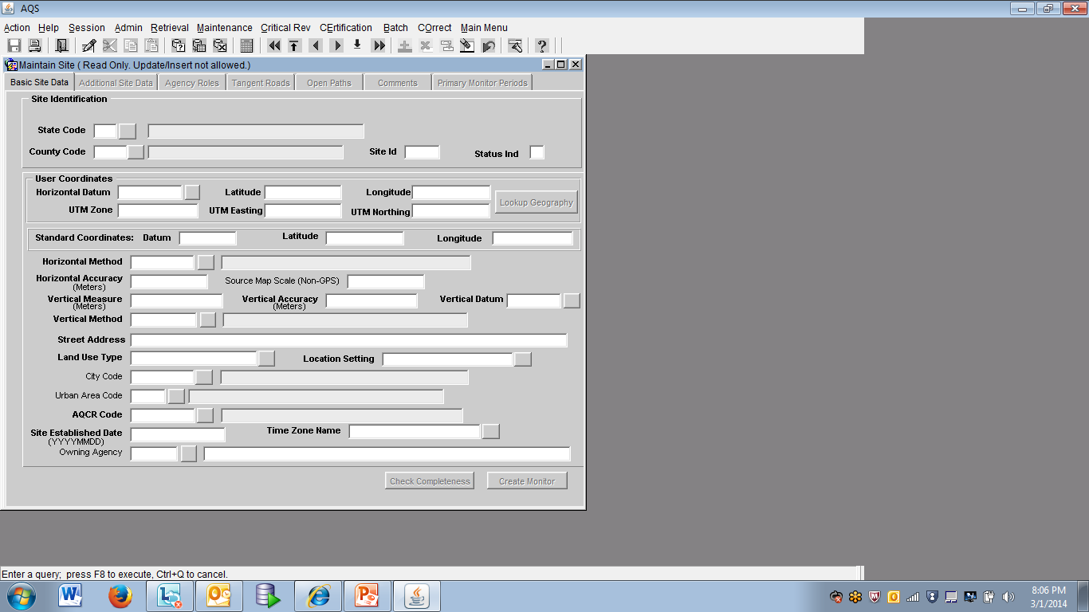
Notes:
Here is the AQS Online Site Form. Print this slide or take a screen shot of the screen in AQS and obtain this information prior to accessing AQS. This is information that the person who sets up the site will have.
You will also need to determine your site id.

Slide 26
Site Id
A numeric identifier (ID) that uniquely identifies each air monitoring site within a county or tribal area. There is no requirement that Site IDs be assigned continuously or in any particular order. Regional and Local organizations are thus free to allocate site numbers in any way they chose as long as there is no duplication within a county and tribal area. For Tribal sites, because tribal areas may cross county or state lines, care must be taken to ensure that the Site ID is unique in the effected Tribal Area and states-county.
A specific Site ID is associated with a specific physical location and address. Any change in address requires a new Site ID to be assigned. This address change could include a change from the roof of one building to another. A change in location on the same roof should not normally require a new Site ID. Although an address change would routinely mean a new Site ID, some changes that do not change the site's location in respect to surrounding sources and its measurement scale, would require no change. An EPA Regional Office should be consulted for assistance in determining whether a new Site ID is required. If a new Site ID is needed for a site not operated by the air pollution control agency, that agency should be contacted to assist in the ID assignment, to ensure that the ID is unique within the county. In other words, when a new Site ID is assigned, it must be different from any other Site ID already existing for that combination of State and County or Tribal Code
Notes:
Here is some information about the Site ID from the AQS Data Coding Manual.

Slide 27
Site ID attributes
Alphanumeric
4-digit ID
Mandatory
Key Field
Notes:
These are the site id attributes.
2.2.6 Key Fields
Certain mandatory fields are also labeled as “Key” fields. These fields are used to uniquely identify specific data in the database. For example, for a Monitor Sampling Period, the Date Sampling Began, is a key field. It, along with {state, county, site, parameter, and POC} uniquely identifies one row of data in the database. Key fields are always mandatory for all Action Indicators, and key fields cannot be modified by an update transaction.

Slide 28
AQS Data Coding Manual is your reference for specific terms
See the AQS Data Coding Manual for information regarding these fields
http://www.epa.gov/ttn/airs/airsaqs/manuals/AQS%20Data%20Coding%20Manual.pdf

Slide 29
Steps for inputting a site via online Maintenance
Access AQS. If not in Tribal Mode, access Tribal Mode.
Access Maintenance > Site and you should be placed on the Basic Site Data tab
On the Basic Site Data tab, click on your Cancel Query button to access input mode
Enter your tribal code
Enter state code
Enter your county code
Do not enter anything in the Status Ind
Enter Horizontal Datum
Enter Latitude/Longitude -OR - UTM Zone/UTM Easting/UTM Northing.
Click on Lookup Geography. Note the Standard Coordinates get populated.

Slide 30
Steps for inputting a site via online Maintenance
11. Continue to enter the rest of the required fields on the Basic Site Data tab which are in bold
12. Optional: Click on the ‘Additional Site Data’ tab and enter any site meta data; else leave blank
13. Required: Click on the Agency Roles tab and enter a Supporting Role
14. Access Tangent Roles tab and specify if your site has one; else leave blank
15. Access Open Paths and specify if your site has one; else leave blank
16. Access Comments tab and specify comment if you want to specify a comment for your site; else leave blank
17. Do not specify anything on the Primary Monitor Periods tab at this point.
18. Go back to the Basic Site Data tab.
19. Click Save.
20. Re-query for your site by clicking on the enter query button and entering your tribal code and site id, click on the execute query button. Check the Status IND. If the Status IND is ‘P’ your are done. If it is not ‘P’, click on the check completeness button at the bottom of the Basic Site Data tab and note any errors or missing data to fix. Fix errors. Save. Re-query site to see if it is at ‘P’ status. Repeat this step until your site is a ‘P’ status.
21. Once your site is at ‘P’ status you are done.

Slide 31
Tips to Creating a Site
All the information on the Basic Site Data tab comes from whomever set up your site. Try to obtain this information before you begin inputting your site data in AQS, else you will not be able to finish. You can print the Basic Site Data screen in AQS beforehand and fill it out.
Obtain your Tribal Code from your AQS Regional Representative or the AQS Team.
You determine your site id. Review the sites you already have in AQS and decide upon a site or consult your regional representative regarding a Site Id
To create a site you access Maintenance>Site
Be sure to click on the Cancel Query button to access input mode before you start inputting your site data
Everything in bold on the Basic Site Data tab is required
After you enter the information on the Basic Site Data tab up to and including the UTM –or- Lat/Long, click on the Lookup Geography button to populate the standard coordinates.
The Agency Roles Tab>Supporting Roles is Required
Information is only required on the Basic Site Data Tab and Agency Roles tabs. The other tabs are site specific and/or optional…or input is required only for certain pollutants (i.e. primary monitor periods tab)
When the Status IND on Basic Site Data Tab changes from ‘F’ to ‘P’ or Production Status your site is complete and you are done
Use the AQS Data Coding Manual if your are unsure of any terms on the site form.

Slide 32
FYI: Presentation Slides
The slides in the presentation contain some notes. You can view and print the notes along with the slides.

Slide 33
Thank you for attending!

